Slide 1
Iris Species through Classification
Exploring the Application of ML in Botany
Introduction to Artificial Intelligence and Data Science
Instructor: Professor Claire

Slide 2
Meet the Team
Machine Engineers
Analysts
-Fred Okorio
-Smart Ronald
-Lamech Lubowa
-Drucilla Nakanwagi
-Kirabo Calvin
-Cristian Timothy

Slide 3
01
Objectives
Goal: To develop a machine learning model for accurately classifying iris species based on species features.
Dataset: link

Slide 4
02
Machine Learning Type
Supervised learning.

Slide 5
03
Justifications
Labeled Data Availability
Accuracy
Evaluation and Optimization
Notes:
Labeled Data Availability: The Iris dataset provides labeled examples of different Iris species.
Accuracy: Supervised learning allows the model to learn and generalize from the labeled data, leading to accurate classification.
Evaluation and Optimization: The model's performance can be evaluated, and parameters can be optimized for better results.

Slide 6
04
Data Overview
Background
Features
Species
Data Exploration
Notes:
Background: Introduction to the Iris dataset and its origin (Fisher's Iris dataset).
Features: Explanation of the four features - sepal length, sepal width, petal length, petal width.
Species: Overview of the three Iris species - Setosa, Versicolor, Virginica.
Data Exploration: Visualizations showing distribution and relationships between features.

Slide 7
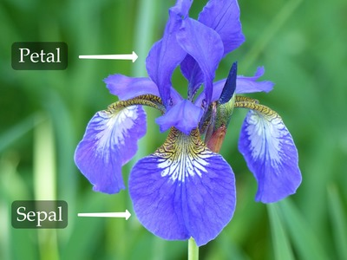
05
Data Overview
Notes:
Background: Introduction to the Iris dataset and its origin (Fisher's Iris dataset).
Features: Explanation of the four features - sepal length, sepal width, petal length, petal width.
Species: Overview of the three Iris species - Setosa, Versicolor, Virginica.
Data Exploration: Visualizations showing distribution and relationships between features.

Slide 8
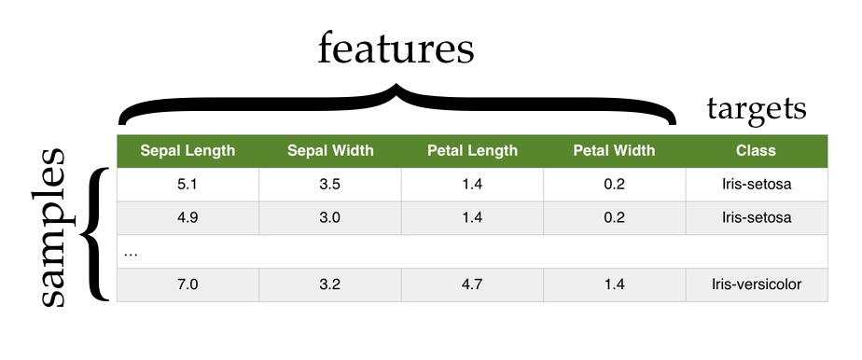
06
Data Overview
Notes:
Background: Introduction to the Iris dataset and its origin (Fisher's Iris dataset).
Features: Explanation of the four features - sepal length, sepal width, petal length, petal width.
Species: Overview of the three Iris species - Setosa, Versicolor, Virginica.
Data Exploration: Visualizations showing distribution and relationships between features.

Slide 9
Thanks!
Do you have any questions?
Merry Christmas and Happy New Year

